Slide 1
C# Basics
Newegg
Mark.X.Mou

Slide 2
Course Content
Basics
Advanced

Slide 3
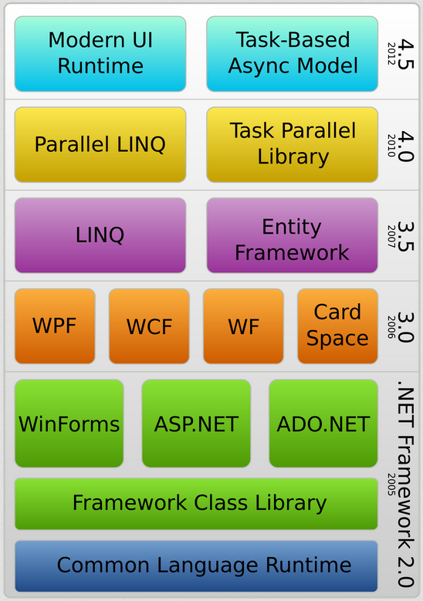
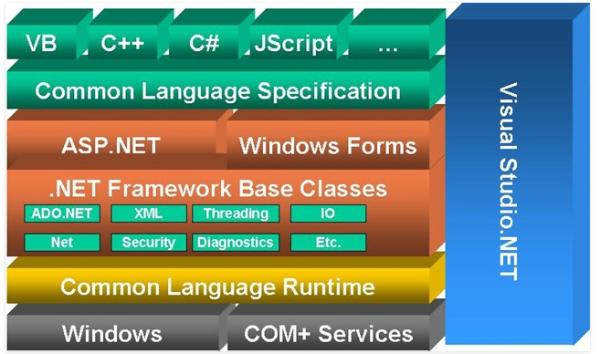
Basics
.NET Framework
What is C#? (C Sharp)

Slide 4
Basics
Managed Language
IL
Your code → Compiler → IL (Assembly)
JIT in CLR
Assembly → Native Code (JIT Compiler)
Platform independent
Unmanaged Language

Slide 5
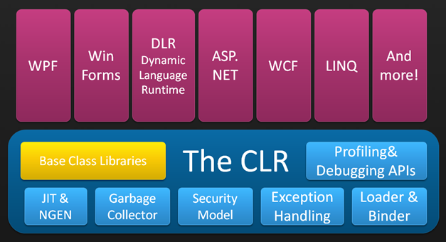
Basics
CLR (Common Language Runtime)
Provide runtime environment for applications based on .NET Framework

Slide 6
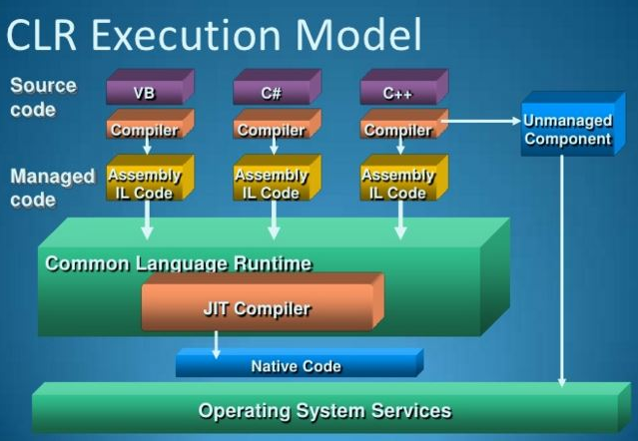
Basics
CLR (Common Language Runtime)

Slide 7
Basics
Namespace
Organize class definitions in a tree structure (directory).
Assembly
IL codes / Resources (.dll)
CS Files
The source code of the C# language (.cs)

Slide 8
Basics
Class
The blueprint of the object.
Instance Properties (Auto properties, read only Properties)
Instance Methods (overloads, default parameters, variable parameter array)
Instance Constructors
Instance Destructors (Finalizer)
Static Constructors
Static Properties
Static Methods

Slide 9
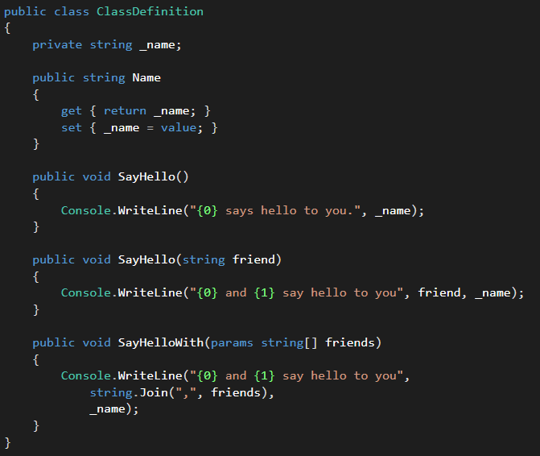
Basics
Class definition

Slide 10
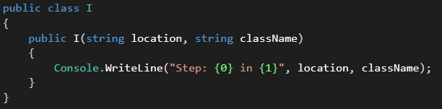
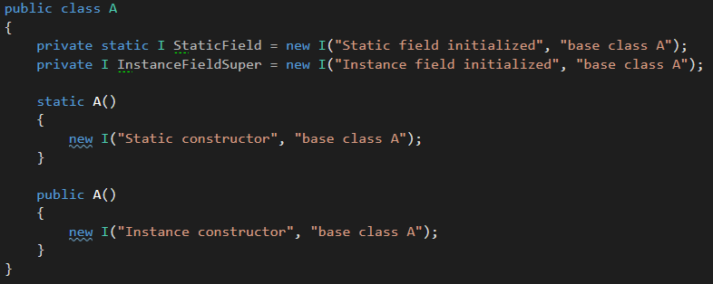
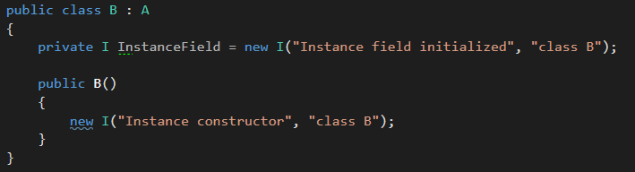
Basics
Class Constructors

Slide 11
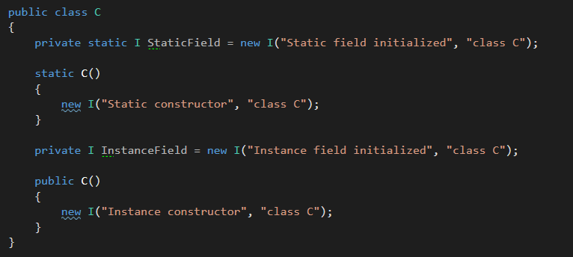
Basics
Class Constructors

Slide 12
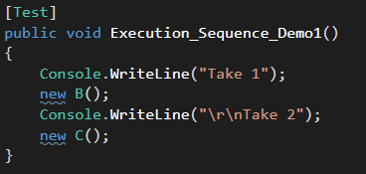
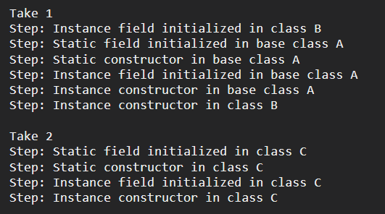
Basics
Class Constructors

Slide 13
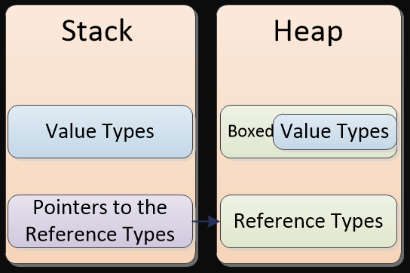
Basics
Value Types vs Reference Types
Value Type
Primitive Types like integer, bool, decimal and etc.
Struct
Reference Type
Class

Slide 14
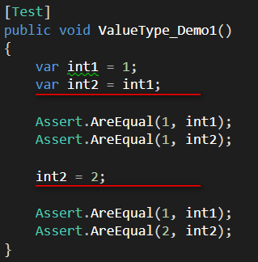
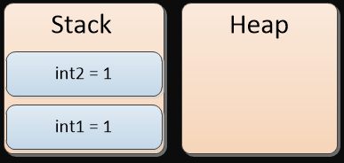
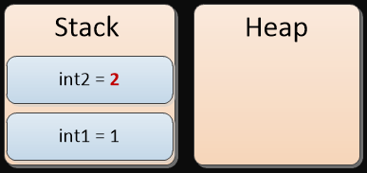
Basics
Value Types

Slide 15
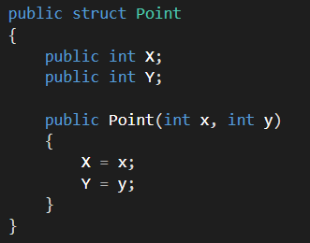
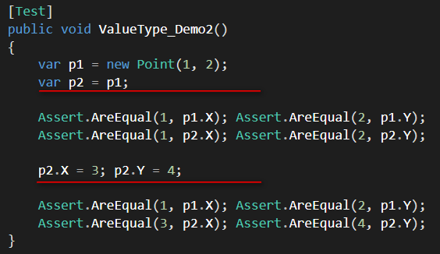
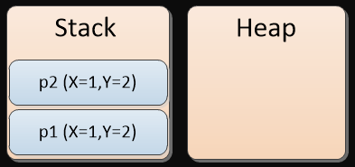
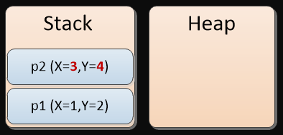
Basics
Value Types

Slide 16

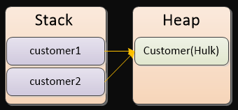
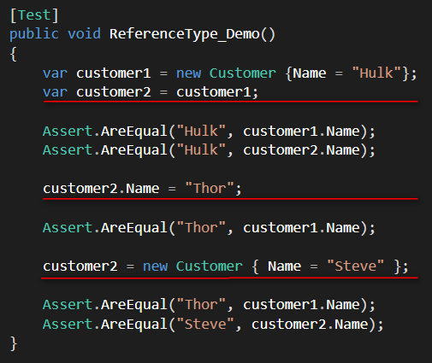
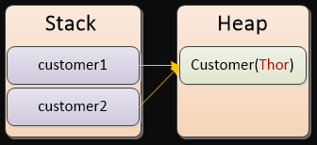
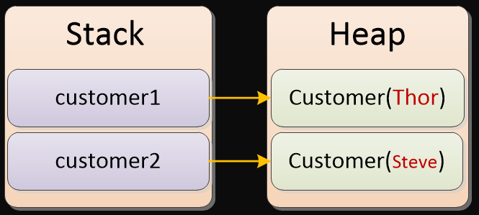
Basics
Reference Types

Slide 17
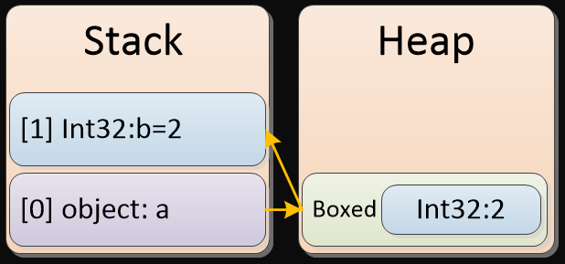
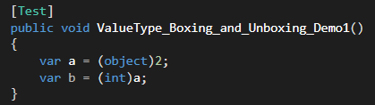
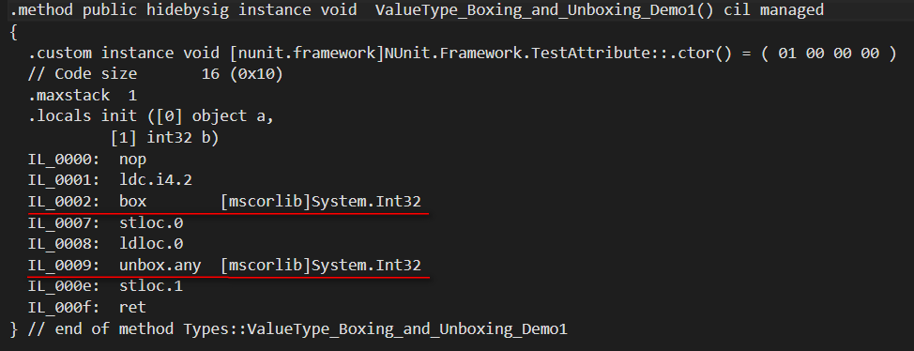
Basics
Boxing and unboxing

Slide 18
Basics
String
A sequence of Unicode characters.
Value type or reference type ?
Immutable(Why?)
Can store only one copy of identical string for different variables.
Thread-safe
StringBuilder
To prevent creating un-used strings.
Regular Expressions
Demo (Demo_01_Basic.Tests.StringDemoTest)

Slide 19
Basics
Access Modifiers:
public
Can be accessed inside/outside of the declaring class and the assembly the class belongs to.
internal
Can be accessed inside/outside of the declaring class and only within the assembly the class belongs to.
protected
Can be accessed inside the declaring class or classes that derived from the declaring class.
private
Can bee accessed inside the declaring class only.

Slide 20
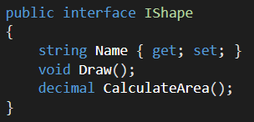
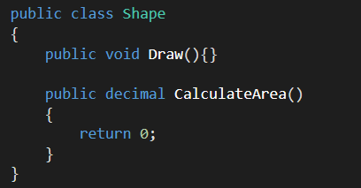
Basics
Interfaces
Definition of some kind of capability
Definition of a contract
Definition of some kind of behavior
Interface CANNOT have implementation
Methods and properties CANNOT have modifiers
All methods and properties are public

Slide 21
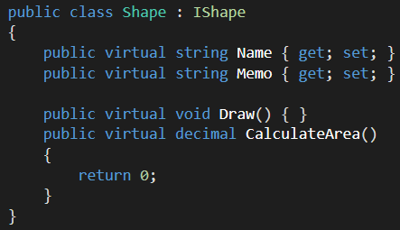
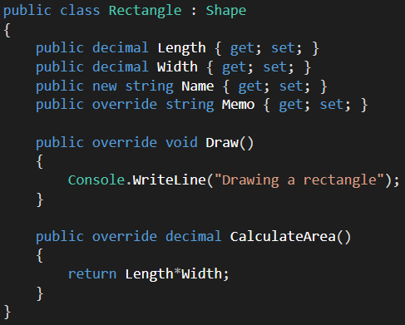
Basics
Inheritance
One class can only inherit from one base class.
One class can implements multiple interfaces.
One interface can inherit from multiple interfaces.

Slide 22
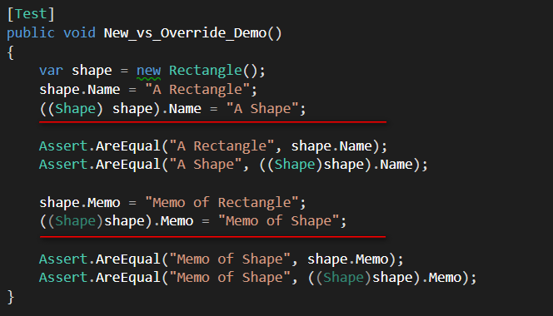
Basics
new vs override

Slide 23
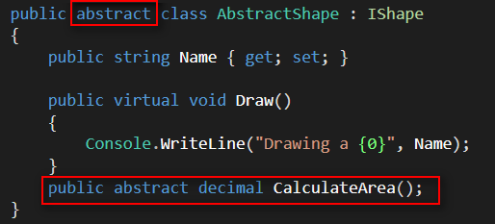
Basics
Abstract Class
Abstract Class vs Interface
Abstract Class can have implementation of methods/properties

Slide 24
Generic
Generic
Generic classes, interfaces
Generic Collections: List<T>, Dictionary<TKey, TValue>, etc.
Demo
Generic methods
Demo
Generic Type Constraint (where)
Demo
default(T)
Value types vs reference types
typeof(T)
Retrieve the actual type of T

Slide 25
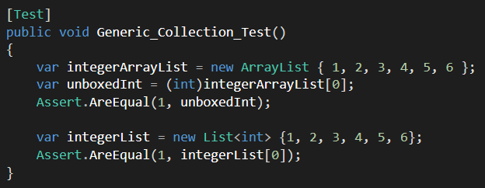
Generic
Why generic?
Avoid boxing / unboxing
Use IL disassembler to see the boxing/unboxing happen.
Type-safe (Complier check)

Slide 26
Exception
What is it?
Some kind of bad event that interrupt the normal program flow.
Exception get propagated from it occurs to the main caller.
Demo
Handling Exceptions
try… catch … finally block
Demo
General Exception vs Customized Exception

Slide 27
Serialization
Serialization
Process of converting object to stream.
Store data/state of an object
Transmit data/state of an object
Clone an object
Deserialization
Process of reconstruct object from stream.
Json vs XML vs …
Demo

Slide 28
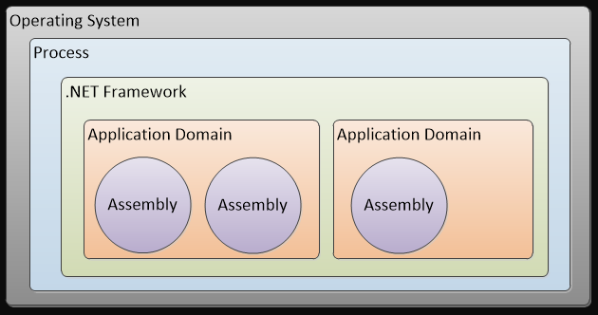
Advanced
Application Domain
Isolation of applications within single process
More secure, type-safe
Traditional application isolation is process based.

Slide 29
Advanced
delegate
Pointer that pointed to a method
Pass a method like other data variables
event
event is a special property-like wrapped delegate.
provide thread-safe
Predefined delegates in .NET Framework
Func<Tin…., TResult> (Overloads)
Action<Tin….> (Overloads)
EventHandler<TEventArgs>
Demo

Slide 30
Advanced
Anonymous methods & lambda expressions
Anonymous methods are introduced from C# 2.0
lambda expressions are introduced from C# 3.0 to supersede anonymous methods
Demo
Extension methods
Extends the functionalities of existing class without modify it.
Defined and can only be defined in a static class
They are static methods with the first parameter marked by this key words
Demo

Slide 31
Advanced
LINQ
Language Integrated Query
Support join, groupby, orderby and even aggregation
Demo
Delayed execution
Execute on iteration
Demo

Slide 32
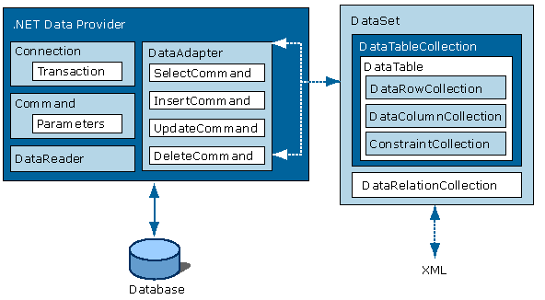
Advanced
Accessing Data
ADO.NET
Demo

Slide 33
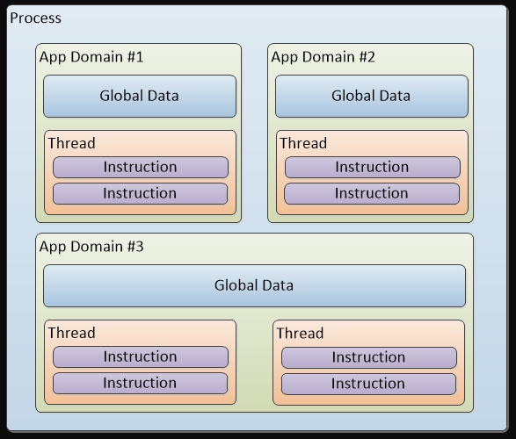
Advanced
Threading

Slide 34
Advanced
Threading
Race condition
When data is accessed concurrently from multiple threads.
Demo
Deadlock
Demo

Slide 35
Advanced
Threading
What is thread safe
Ensure the program don’t go crazy.
To prevent it running in unexpected behavior.
Locking
Demo

Slide 36
Advanced
Reflection
Retrieving properties and access it
Retrieving methods and invoke it
Creating instance of a type
Determine relationships between types (class and interface)
It is possible to call unmanaged code.
Attributes
Demo

Slide 37
Advanced
Memory Allocation
Managed heap vs Stack
Stack (Value types)-> scope
Managed heap (Reference types) -> Garbage Collector
When it happens
new Something
Boxing/Unboxing
and more (lambda expression, params arrays)

Slide 38
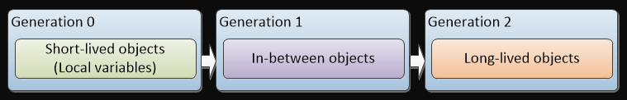
Advanced
Garbage Collection
Release unused(unreferenced) objects
Objects in an application formed as a forest.
Application Roots
Global and static object pointers
CPU registers with heap pointers
Thread stack object pointers
Freeze all threads to protect heap when it happen.
Generations

Slide 39
Advanced
String Interning
Create a reference to the string in memory for AppDomain lifetime. (intern pool)
No GC on intern pool
Lot of long-lived, few unique -> good
Lot of long-lived, many unique -> no benefit, memory growth
Lot of short-lived -> trust the GC

Slide 40


Advanced
String Interning
Memory Test

Slide 41
Q&A

Slide 42
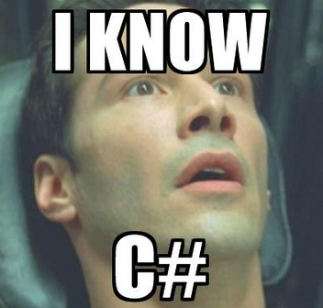
END
THANKS
mailto: mark.x.mou@newegg.com

